Slide 1
Password Generator
JAVA MINI PROJECT
TEAM NAME : AHR
A - AMIRTHA VARSHINI
H - HARSHINI
R - REKHA

Slide 2
Introduction:
In Java, a form for entering authentication credentials to access the restricted page is referred to as a Login form. A login form contains only two fields, i.e., username and password. Each user should have a unique username that can be an email, phone number, or any custom username.
After submitting the login form, the underlying code of the form checks whether the credentials are authentic or not to allow the user to access the restricted page. If the users provide unauthentic credentials, they will not be able to forward the login form.
In Java, we can develop the login form by using Swing technology. We implement the LoginFormDemo.java class in which we create two text fields, i.e., text1 and text2, for setting the username and password. We also create a button for performing the action.

Slide 3
Program:
CLASS NAME : Main.java
public class Main {
public static void main(String[] args) {
IDandPasswords idandPasswords = new IDandPasswords();
LoginPage loginPage = new LoginPage(idandPasswords.getLoginInfo());
}
}

Slide 4
CLASS NAME : IDandPasswords.java
import java.util.HashMap;
public class IDandPasswords {
HashMap<String,String> logininfo = new HashMap<String,String>();
IDandPasswords(){
logininfo.put("Bro","pizza");
logininfo.put("Brometheus","PASSWORD");
logininfo.put("BroCode","abc123");
}
public HashMap getLoginInfo(){
return logininfo;
}
}

Slide 5
CLASS NAME : LoginPage.java
import java.awt.*;
import java.awt.event.*;
import java.util.*;
import javax.swing.*;
public class LoginPage implements ActionListener{
JFrame frame = new JFrame();
JButton loginButton = new JButton("Login");
JButton resetButton = new JButton("Reset");
JTextField userIDField = new JTextField();
JPasswordField userPasswordField = new JPasswordField();

Slide 6
JLabel userIDLabel = new JLabel("userID:");
JLabel userPasswordLabel = new JLabel("password:");
JLabel messageLabel = new JLabel();
HashMap<String,String> logininfo = new HashMap<String,String>();
LoginPage(HashMap<String,String> loginInfoOriginal){
ogininfo = loginInfoOriginal;
userIDLabel.setBounds(50,100,75,25);
userPasswordLabel.setBounds(50,150,75,25);
messageLabel.setBounds(125,250,250,35);
messageLabel.setFont(new Font(null,Font.ITALIC,25));

Slide 7
=userIDField.setBounds(125,100,200,25);
userPasswordField.setBounds(125,150,200,25);
loginButton.setBounds(125,200,100,25);
loginButton.setFocusable(false);
loginButton.addActionListener(this);
resetButton.setBounds(225,200,100,25);
resetButton.setFocusable(false);
resetButton.addActionListener(this);

Slide 8
frame.add(userIDLabel);
frame.add(userPasswordLabel);
frame.add(messageLabel);
frame.add(userIDField);
frame.add(userPasswordField);
frame.add(loginButton);
frame.add(resetButton);
frame.setDefaultCloseOperation(JFrame.EXIT_ON_CLOSE);
frame.setSize(420,420);
frame.setLayout(null);
frame.setVisible(true);

Slide 9
}
@Override
public void actionPerformed(ActionEvent e) {
if(e.getSource()==resetButton) {
userIDField.setText("");
userPasswordField.setText("");
}
if(e.getSource()==loginButton) {
String userID = userIDField.getText();
String password = String.valueOf(userPasswordField.getPassword());

Slide 10
if(logininfo.containsKey(userID)) {
if(logininfo.get(userID).equals(password)) {
messageLabel.setForeground(Color.green);
messageLabel.setText("Login successful");
frame.dispose();
WelcomePage welcomePage = new WelcomePage(userID);
}
else {
messageLabel.setForeground(Color.red);
messageLabel.setText("Wrong password");
}

Slide 11
}
else {
messageLabel.setForeground(Color.red);
messageLabel.setText("username not found");
}
}
}
}

Slide 12
CLASS NAME : WelcomePage.java
import java.awt.*;
import javax.swing.*;
public class WelcomePage {
JFrame frame = new JFrame();
JLabel welcomeLabel = new JLabel("Hello!");
WelcomePage(String userID){
welcomeLabel.setBounds(0,0,200,35);
welcomeLabel.setFont(new Font(null,Font.PLAIN,25));
welcomeLabel.setText("Hello "+userID);
frame.add(welcomeLabel);

Slide 13
frame.setDefaultCloseOperation(JFrame.EXIT_ON_CLOSE);
frame.setSize(420, 420);
frame.setLayout(null);
frame.setVisible(true);
}
}

Slide 14
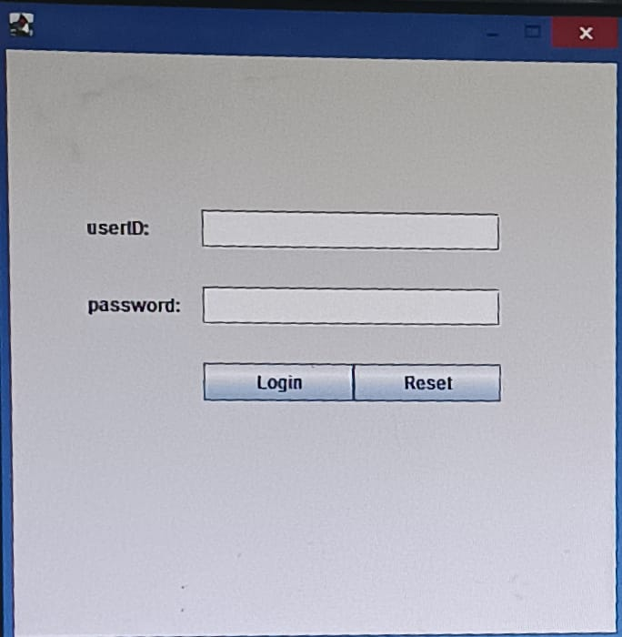
OUTPUT:

Slide 15
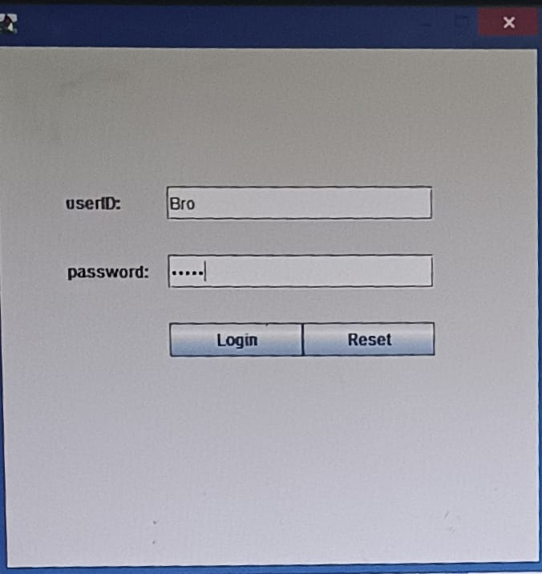
INPUT PASSWORD

Slide 16
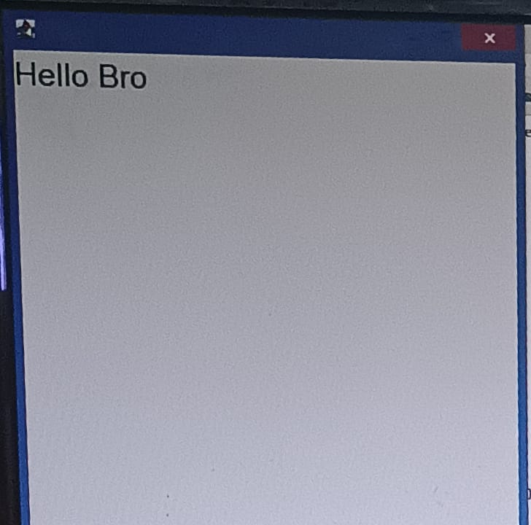
WELCOME PAGE

Slide 17
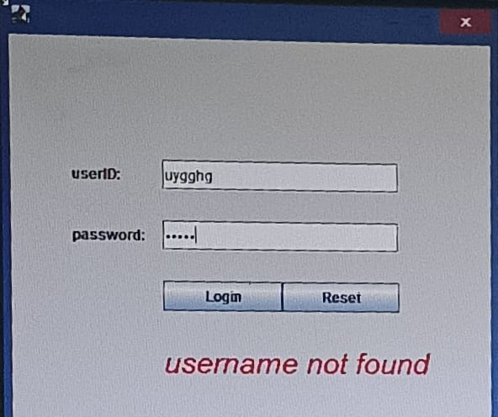
FOR WRONG PASSWORD

Slide 18
THANK YOU

